Slide 1

Web Hacking Extreme Bootcamp

Slide 2

Security Assertion Markup Language (SAML)

Slide 3
Topics
Introduction
Core Components
Testcases
Exploitation and Attack scenarios
Mitigations

Slide 4
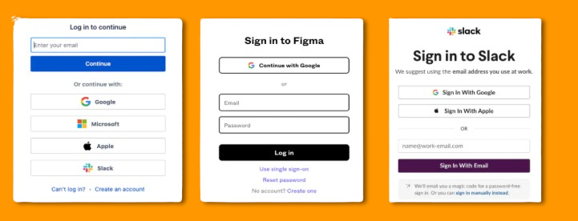

Single Sign-on (SSO)
SSO (Single Sign-on) is a user authentication method that allows users to do authentication with multiple applications using a single set of credentials. Users can log in once into the system and gain access to all the authorized resources without the need for additional authentication.
Notes:
Companies which provide the SAML Authentication, give examples for it.

Slide 5
Introduction to SAML
Security Assertion Markup Language (SAML) is an XML-based framework for Single Sign-On (SSO) and identity federation.
You’ve more likely experienced SAML authentication in action in the work environment.
For example, it enables you to log into your corporate intranet or IdP and then access numerous additional services, such as Salesforce, Box, or Workday, without having to re-enter your credentials.
Notes:
Because SAML transports signed XML assertions that allow one security domain to authenticate users for another, enabling SSO and identity federation without sharing credentials.

Slide 6
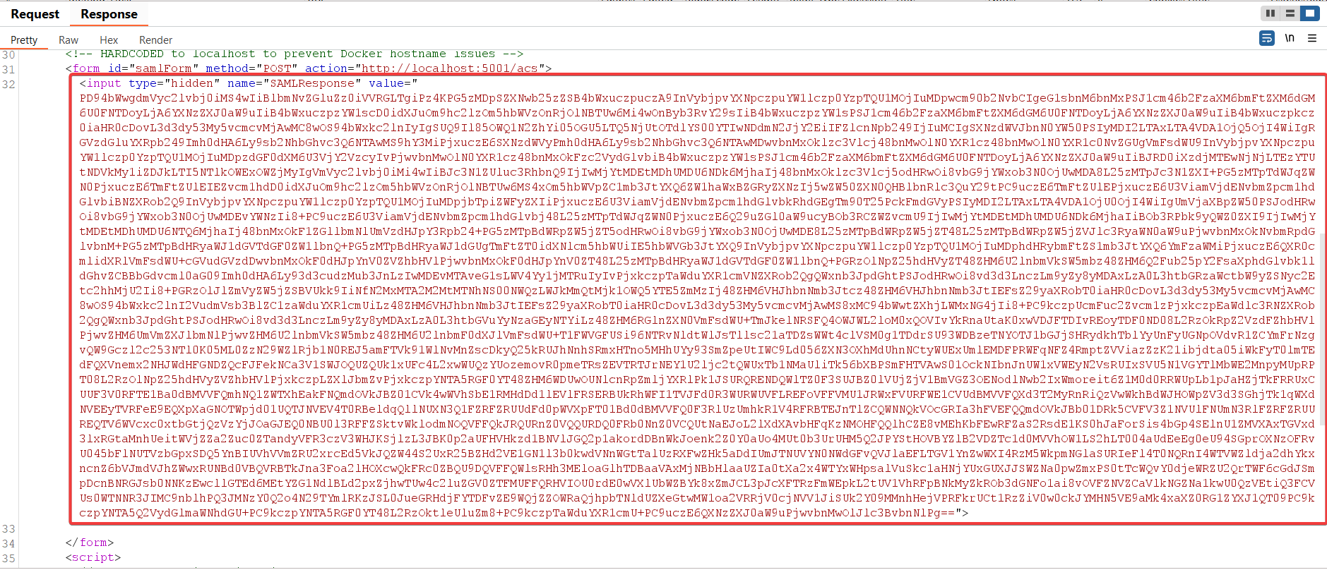
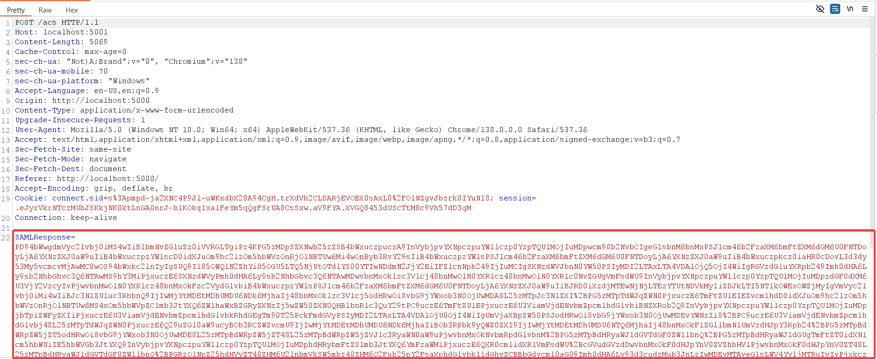
POV ☺

Slide 7
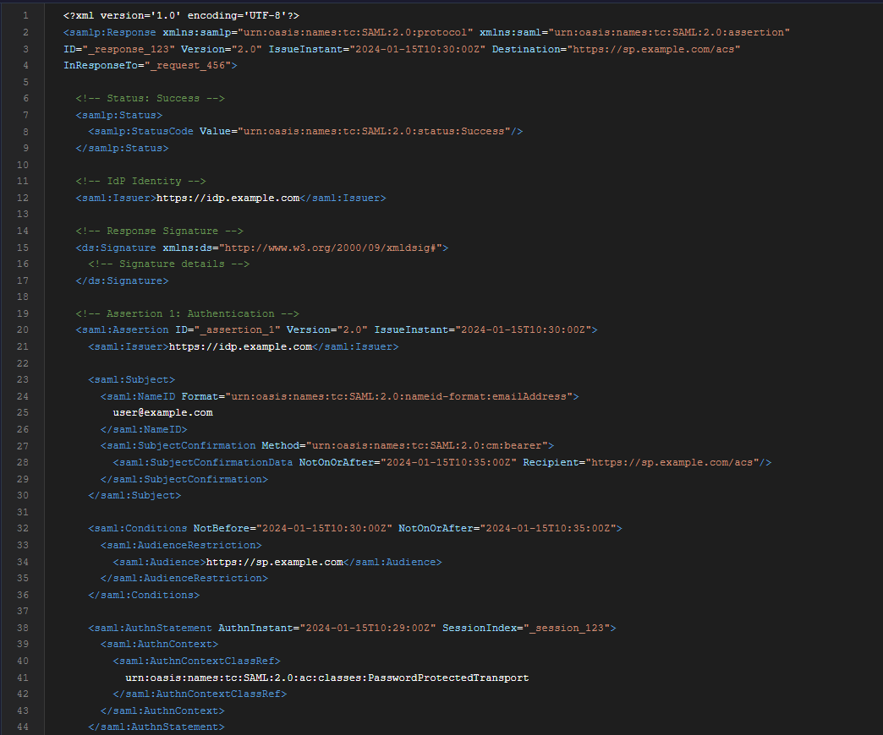
Core Concepts
Authentication Flow
Assertions, Protocols, Bindings and Profiles
SAML Schema Structure

Slide 8
3 Trinity of SAML
Identity Provider (IdP): Authenticates users and issues SAML assertions (XML documents confirming identity and permissions)
Service Provider (SP): Relies on the IdP's assertions to grant access to its services
User-Agent: The person seeking access to the SP's resources

Slide 9
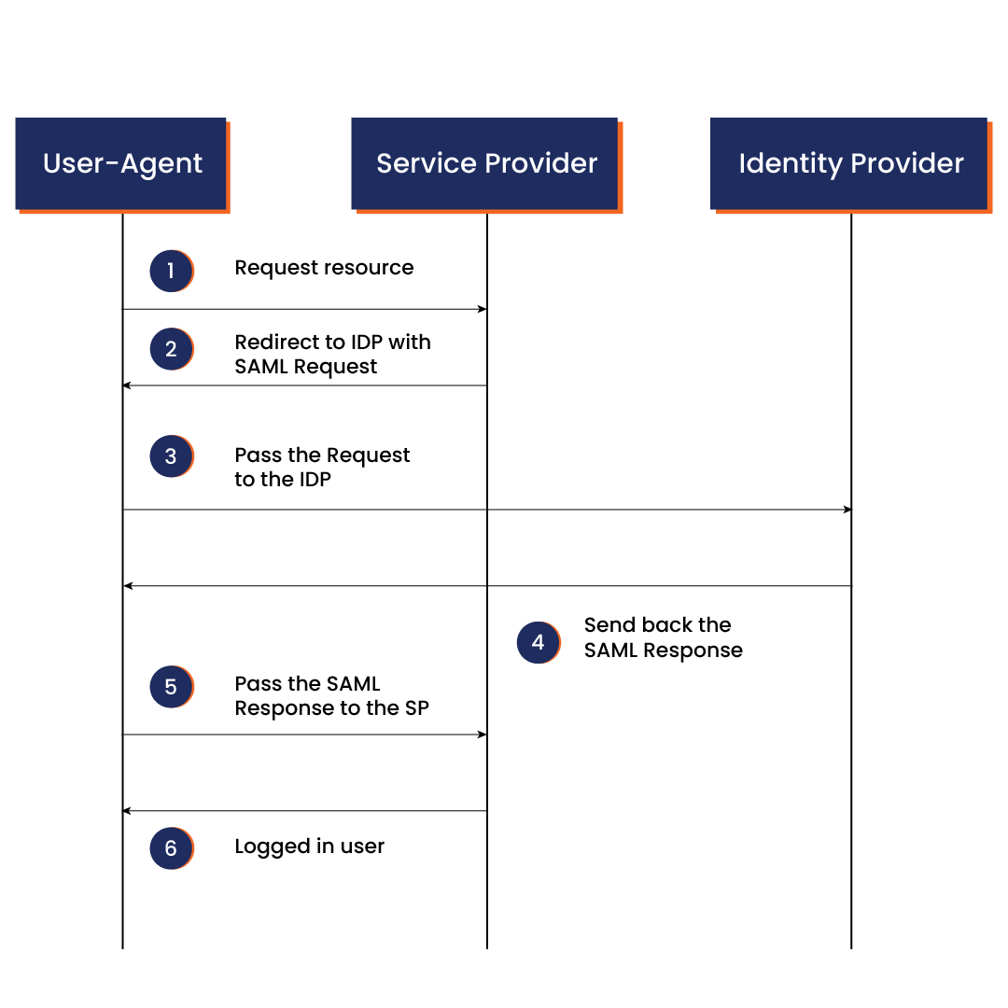
Authentication Flow
Notes:
IdP creates assertion: IdP gathers user info and creates an XML SAML Assertion.
IdP signs: IdP hashes the assertion using a Signature Method (e.g., SHA-256) and encrypts the hash with its private key.
IdP sends: IdP sends the assertion along with its X.509 certificate (containing the public key) to the SP.
SP verifies: SP uses the public key from the X.509 certificate to decrypt the signature. It then independently hashes the received assertion using the same Signature Method and compares the hashes. If they match, the message is authentic and untampered.

Slide 10
SAML Assertion
It is written in XML (Extensible Markup Language), including the identity information and attributes of the user. Identity information can include usernames, email addresses, roles and other attributes that SPs can use to provide personalization.
SAML assertions play a crucial role in SAML-based SSO by conveying trusted information about the user's identity from the Identity Provider (IdP) to the Service Provider (SP). The SP depends on the assertions to make access control decisions and grant users access to protected resources or services.
There are three types of SAML assertions based on their purpose and the information they share:
Authentication Assertion asserts that the IdP has authenticated the user.
Attribute Assertion contains additional attributes about the user's identity and characteristics.
Authorization Decision Assertion specifies the authorization decision made by the IdP based on the user's attributes.

Slide 11
SAML Protocols
SAML protocols define the standard format and rules for sharing authentication and authorization data between systems.
There are several SAML protocols, including:
The Single Logout (SLO) protocol allows users to log out of all the accounts using a single action.
The Single Sign-On (SSO) protocol enables them to log in to multiple accounts with a single login action.

Slide 12
SAML Bindings
SAML bindings specify how SAML messages are exchanged between IdP and SP, defining transport mechanisms and formats. There are several types of SAML bindings for specific purposes. Among them, HTTP POST and redirect bindings are the most commonly used:
HTTP Redirect binding enables encoding SAML messages, especially when they are too large, and redirects the user to the destination.
HTTP POST binding allows encoding SAML messages as HTML form parameters.

Slide 13
SAML Profiles
SAML profiles define how other SAML components should be combined to form the SAML request for different contexts or scenarios, specifying the required rules, constraints and configurations. The profile guides how SAML protocols, bindings and other components must be used to achieve the expected behavior in different scenarios.
For example, an SSO profile specifies what bindings are required for successful sign-in. Meanwhile, a single logout profile defines all the necessary behaviors and requirements for a successful system logout.

Slide 14
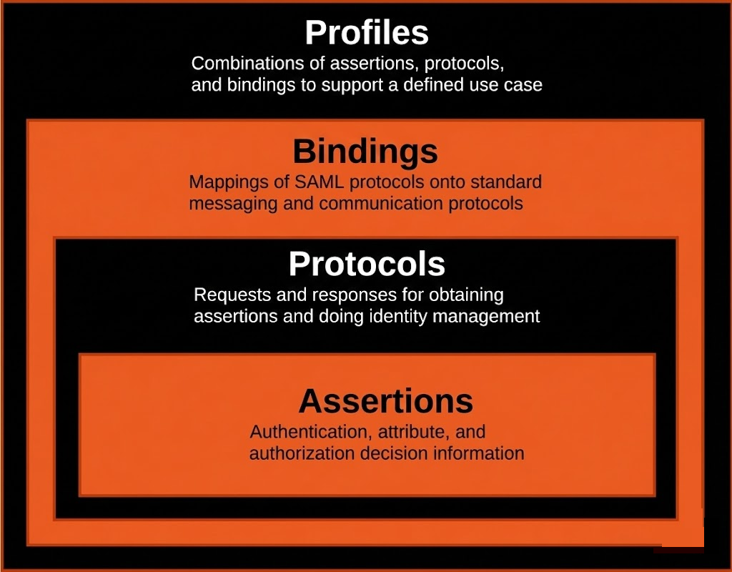
Summarize

Slide 15
Schema Definitions
Schema Definition: According to SAML 2.0 schema, <samlp:Response> has this structure:<samlp:Status> (required)
<samlp:Response>
<samlp:Status>
<saml:Issuer>
<ds:Signature>
<saml:Assertion>
<samlp:EncryptedAssertion>
</samlp:Response>

Slide 16
Testcases
Signature Stripping Attack
Signature Bypass
XML Signature Wrapping (XSW) Attack (1 to 8)
ACS Spoofing Attack / Cross-Tenant SAML Token Attack
Comment Injection
Relay Attack
Gold SAML Attack

Slide 17
Signature Stripping
In SAML, trust lives inside the XML Signature.
If the Service Provider (SP) fails to strictly require and validate that signature, an attacker can:
Remove the <ds:Signature> entirely Modify critical fields like NameID, Attributes, or Audience
Still get authenticated if the SP blindly parses the assertion

Slide 18
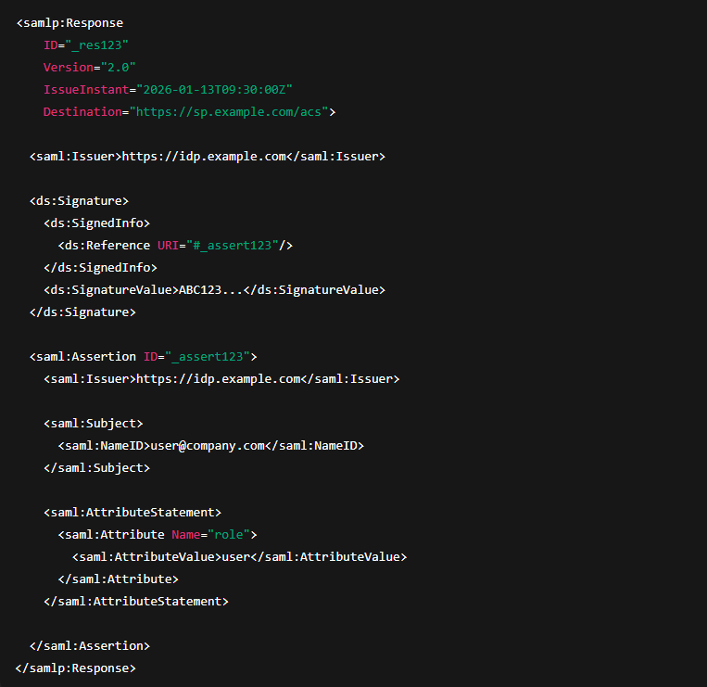
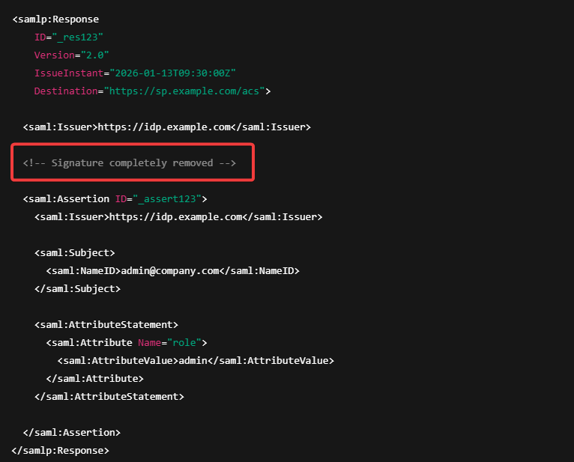
Signature Stripping
Valid SAML Response (✅)
Tampered SAML Response (‼️)

Slide 19
Signature Bypass

Slide 20


Slide 21
XML Signature Wrapping (XSW) attack
XSW attacks exploit XML signature validation by manipulating the document structure so the signature remains valid while the processed content is changed.
XSW attacks are like forgeries slipped into an XML envelope.
The signature is valid, the document is altered, and the application reads the attacker’s version.
For e.g. Same seal, different letter.
Notes:
https://github.com/CompassSecurity/SAMLRaider?tab=readme-ov-file

Slide 22
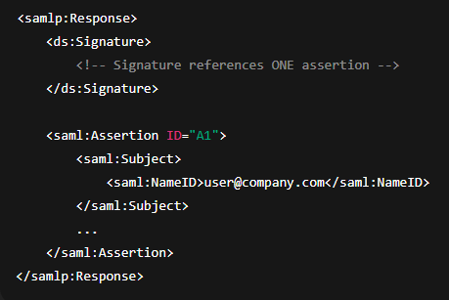
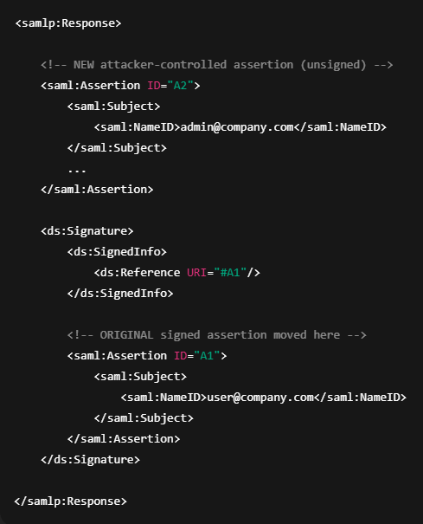
XSW1 Attack
What originally exists in a normal SAML Response
After attack, structure looks like this

Slide 23
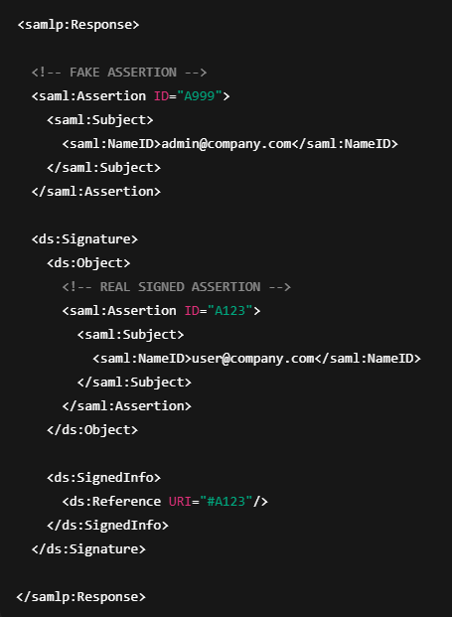
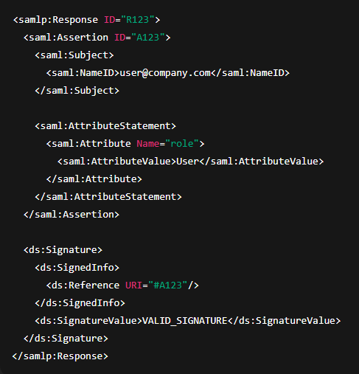
XSW2 Attack

Slide 24
Comparing XSW Attacks
XSW Type | Main Trick Used | Key Weakness
XSW-1 | Element wrapping | Wrong node selection
XSW-2 | <ds:Object> abuse | Signature object misuse
XSW-3 | Duplicate assertion | First/last match logic
XSW-4 | Reference manipulation | URI resolution
XSW-5 | Multiple assertions | Ambiguous parsing
XSW-6 | Namespace confusion | Namespace mismatch
XSW-7 | Comment/CDATA | Parser differences
XSW-8 | XPath/schema abuse | Weak XPath validation

Slide 25
SAML vs OAuth
Feature | SAML 2.0 | OAuth
Protocol | SAML is an authentication protocol. | OAuth is an authorization protocol.
Usage Scenario | SAML 2.0 will be used by those who are looking for federation and identity management. They will use this identity to login the users to different applications. | OAuth will be used by those who are not looking to maintain identities but are rather trying to leverage the implementation of secure protocol by applications such as Google, Microsoft, Paypal, who ensure that the identities are authentic.
Suitable Application | SAML 2.0 is popular for browser-based applications. | OAuth is suitable for both browser and mobile applications.
Commonly Used By | SAM 2.0 is widely used for enterprise applications. | OAuth is widely used for customer applications and API access.
Data Format | SAML 2.0 uses XML to transfer messages between applications. | OAuth uses JSON to transfer messages between applications.

